Slide 1

18 Things to do When you Have a MySQL Bottleneck
Peter Zaitsev,
CEO, Percona
I-Hunt.io Live Stream
September 11th, 2020
From Traffic Spike

Slide 2
Causes of Slowdown
Application Traffic Spike
Grow of the Data Set
MySQL Internal Operations
Application Code Changes
OS/Hardware/Cloud Environmental Factors

Slide 3
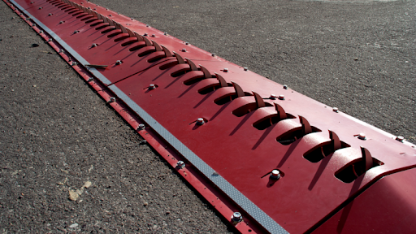
Focus on the Traffic Spike
Each cause has different applicable techniques and solutions, we focus on Traffic Spike in this Presentation

Slide 4

Something you can do NOW
Focus on Changes which you can implement in Hours or Days, not weeks or Months

Slide 5
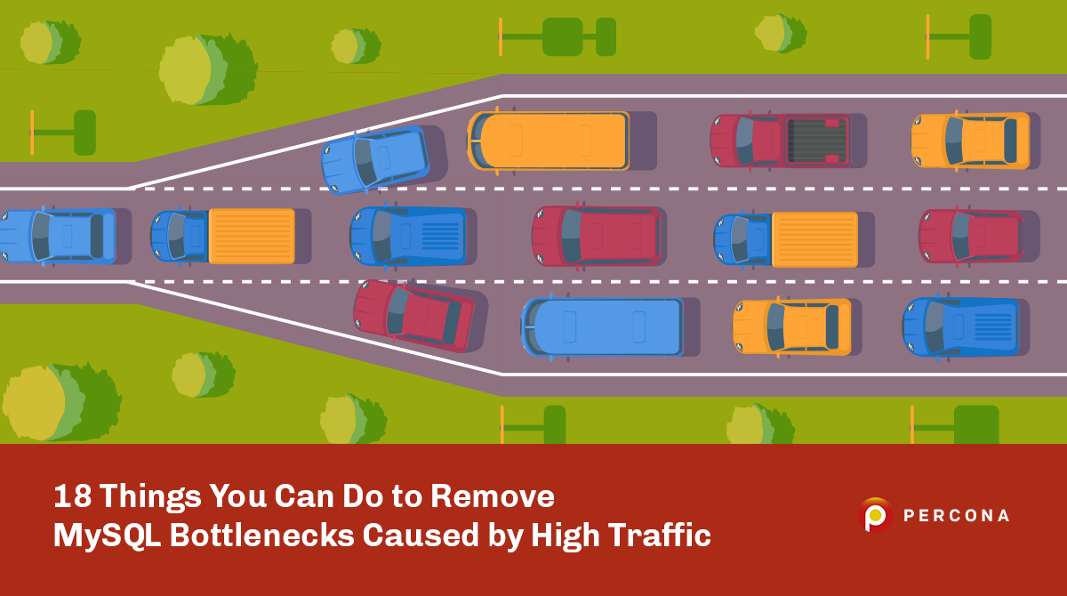
Companion Article
https://per.co.na/18Things

Slide 6
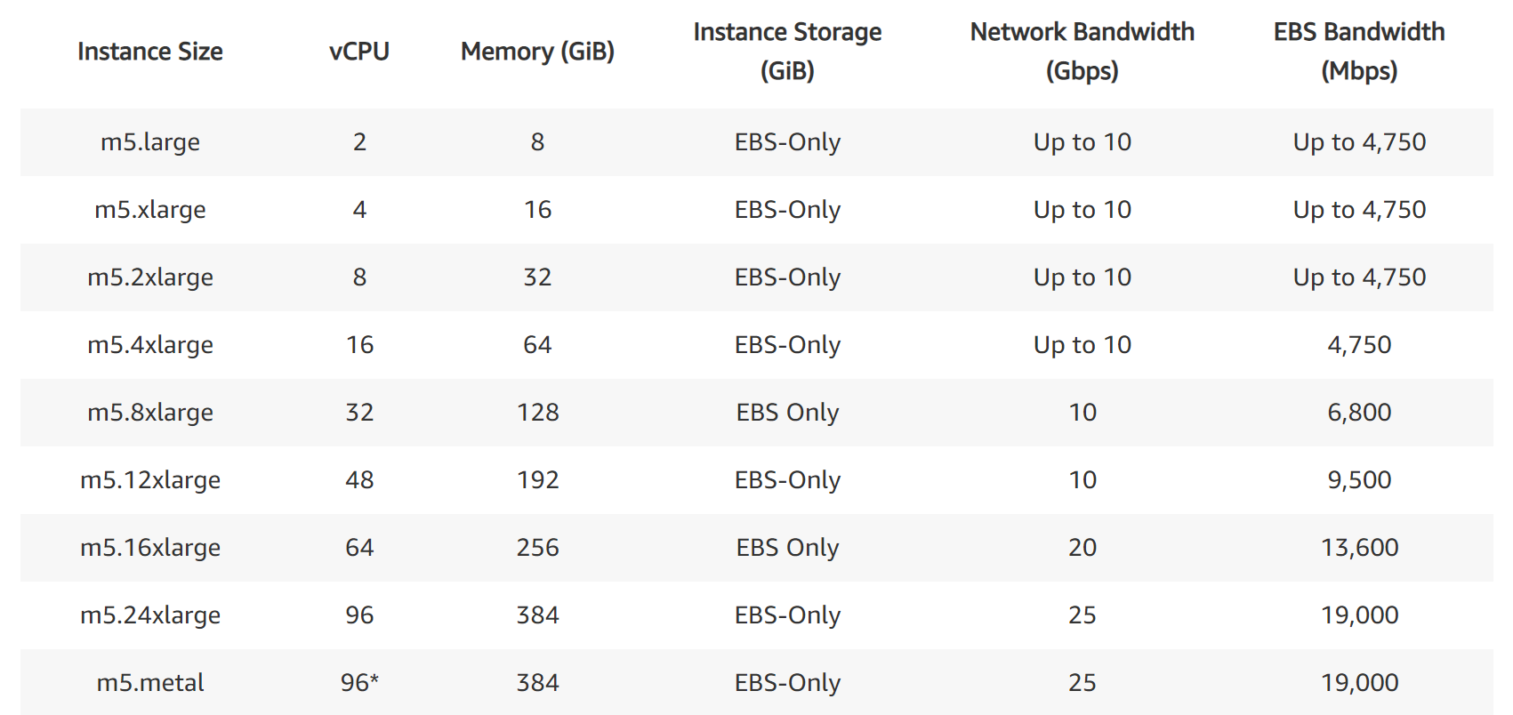
#1 Scale your Cloud Instance Size
https://aws.amazon.com/ec2/instance-types/

Slide 7
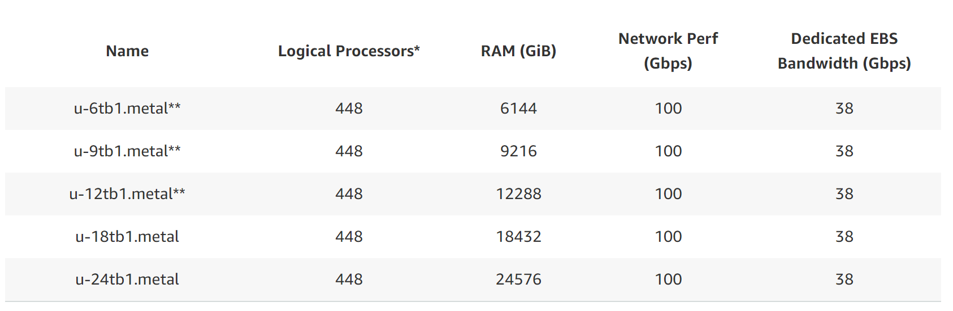
Scaling Instance Size when Money are not concern

Slide 8
Best Practice
Scaling by the Credit Card
Use As Temporary Solution
While you find more cost effective options
Or until Traffic Spike Passes

Slide 9
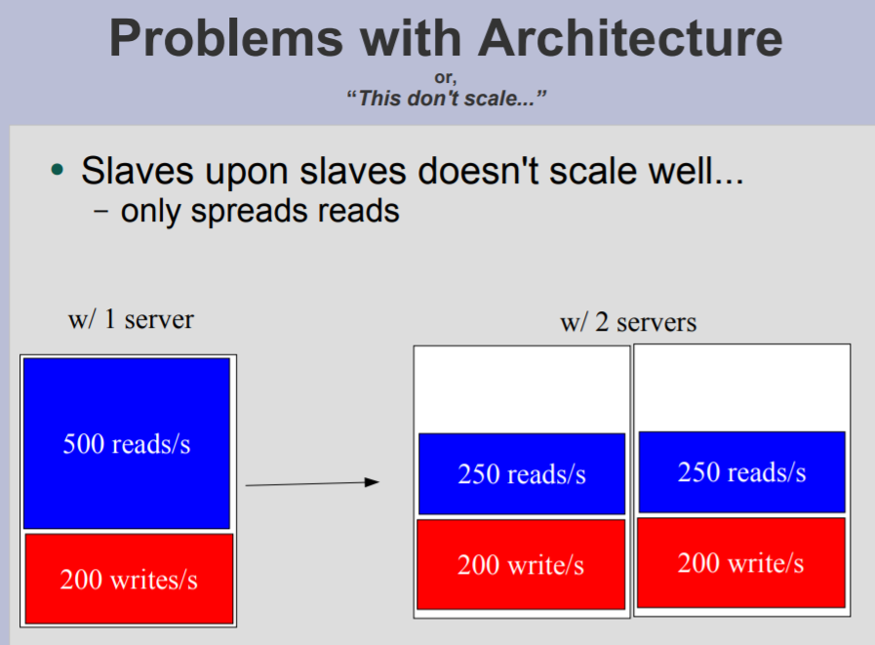
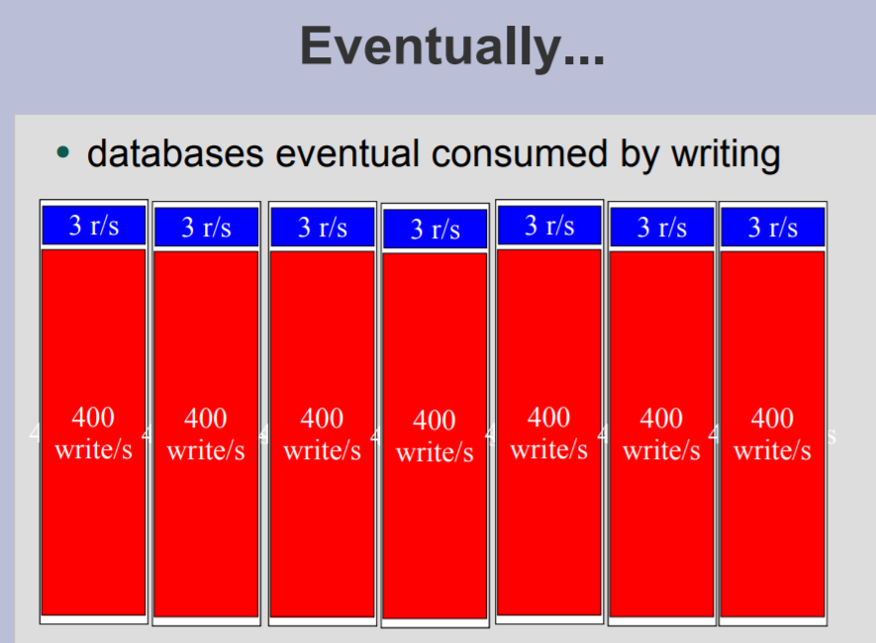
#2 Deploy More MySQL Slaves

Slide 10
Read Intensive Applications
Works best for Read Intensive Applications
Still needs massive amount of data copies (you pay for)
Caching not very efficient due to many copies in memory
Changing Application to get advantage of Replicas may be hard

Slide 11

#3 Deploy ProxySQL

Slide 12
ProxySQL Considerations
Great for Connection Pooling
Can assist with Read-Write Splitting
Supports TTL (Time to Live) based Query Caching
Helps to improve High Availability with Failover Handling

Slide 13
Why NOT ProxySQL
ProxySQL is NOT 100% MySQL Compatible
Some application Adjustments may need be required
ThreadPool in Percona Server for MySQL, MariaDB
Connection Pool in your Application Server (Java etc)

Slide 14
#4 Disable Heavy Load Application Features
Great Application Design Practice – allow disabling features easier
What Are high load and low business value features ?
Can be applied to specific users too

Slide 15

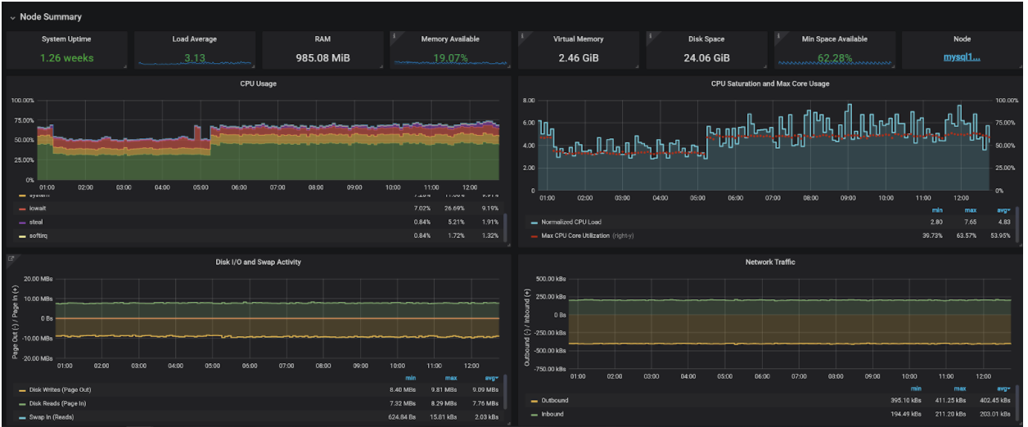
#5 Check for Resource Bottlenecks
https://per.co.na/PMM

Slide 16

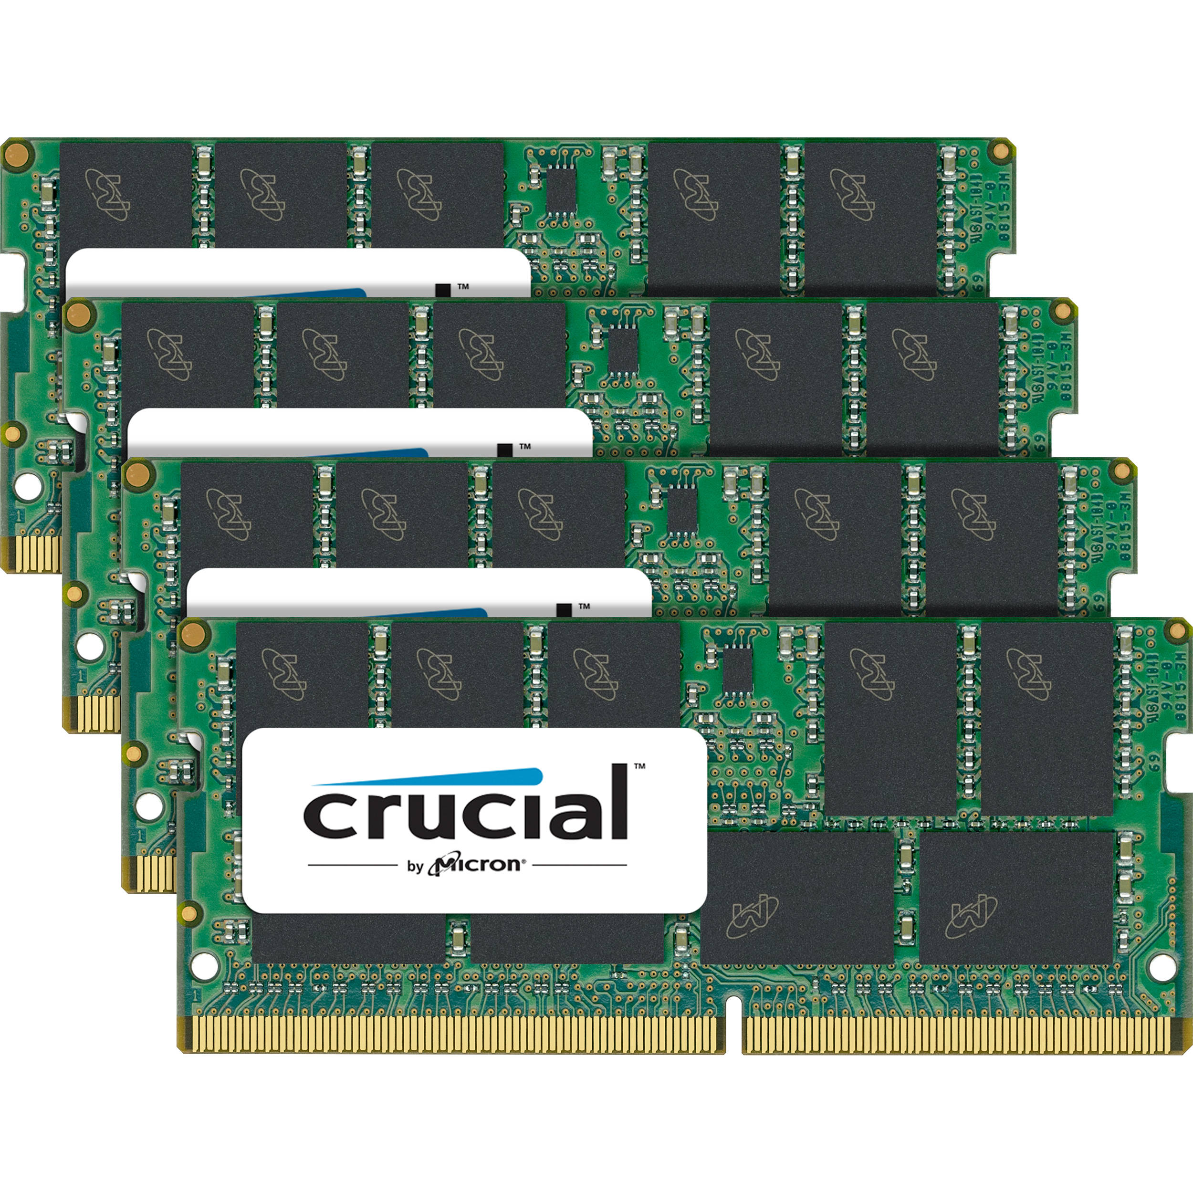
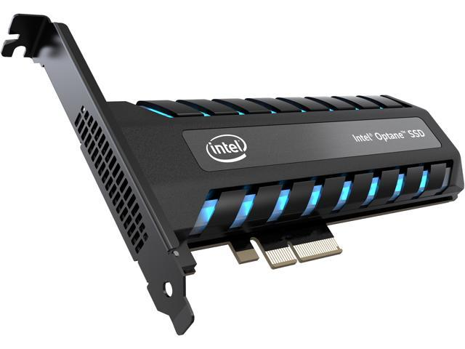
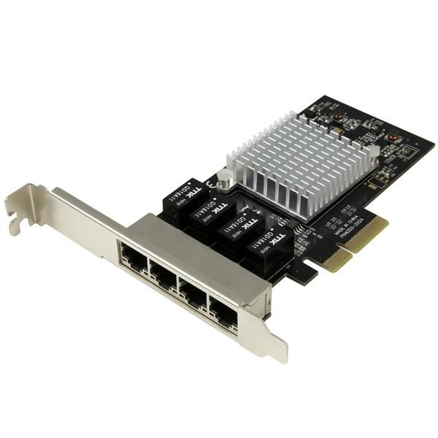
Primary Raw Resources of a System

Slide 17
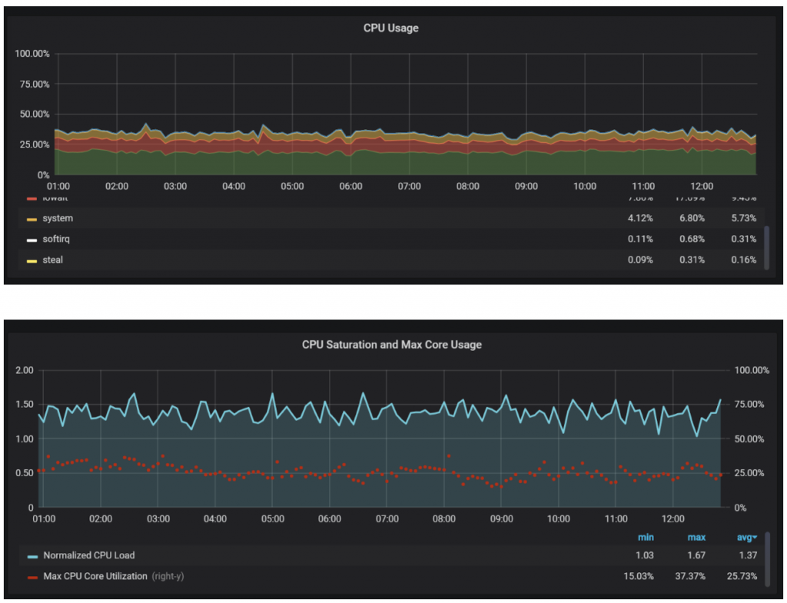
#6 Get More CPU Cores, or Faster Cores

Slide 18
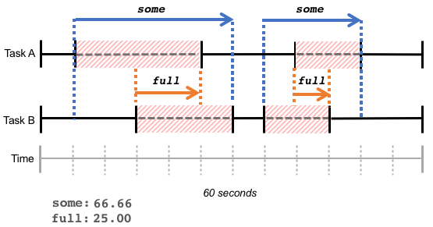
PSI – Available in Recent Linux Distributions as Ubuntu 20.04 LTS
PSI – Pressure Stall Information
https://facebookmicrosites.github.io/psi/docs/overview

Slide 19
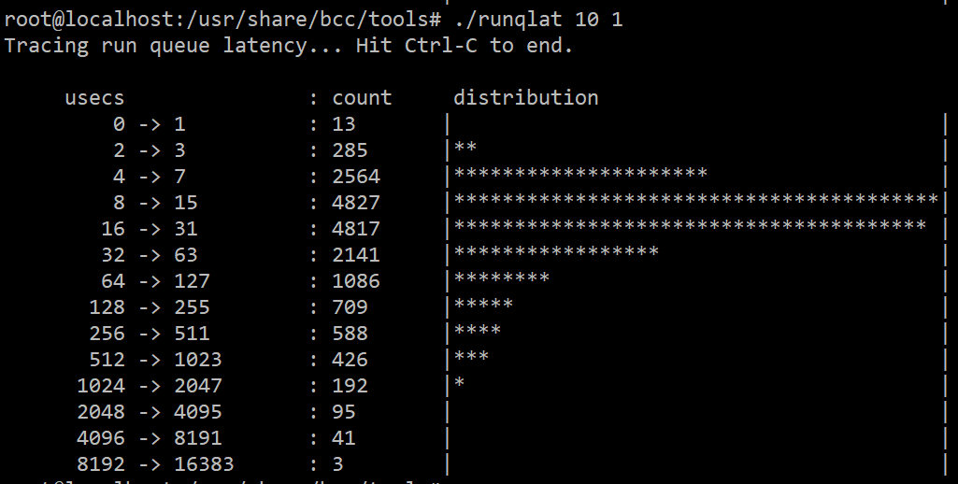
Look at Run Queue Latency
Tool from BCC Tools Collection https://github.com/iovisor/bcc

Slide 20
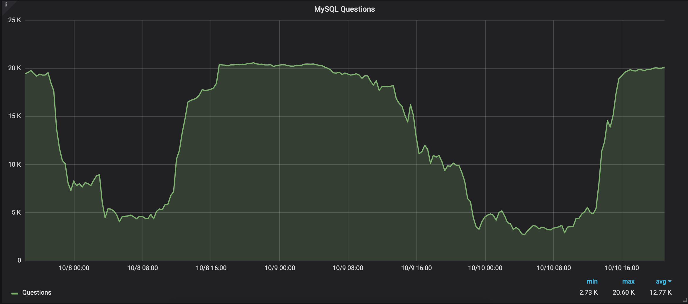
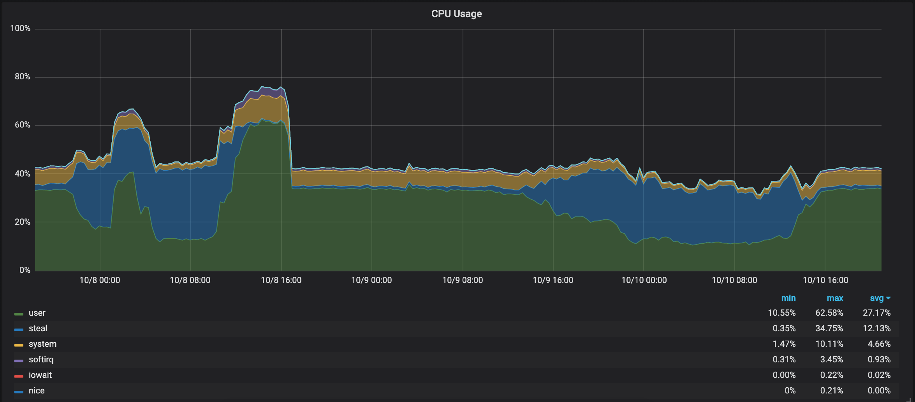
Beware of Stealing

Slide 21
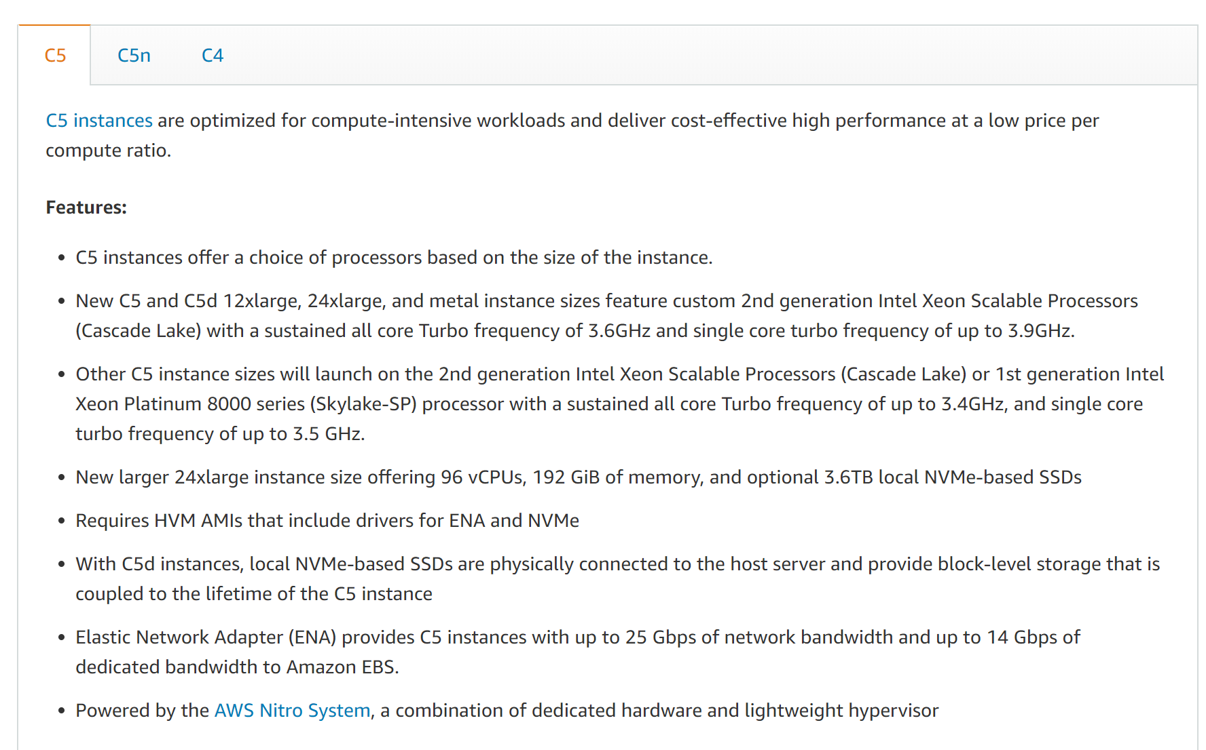
“Compute Optimized”

Slide 22
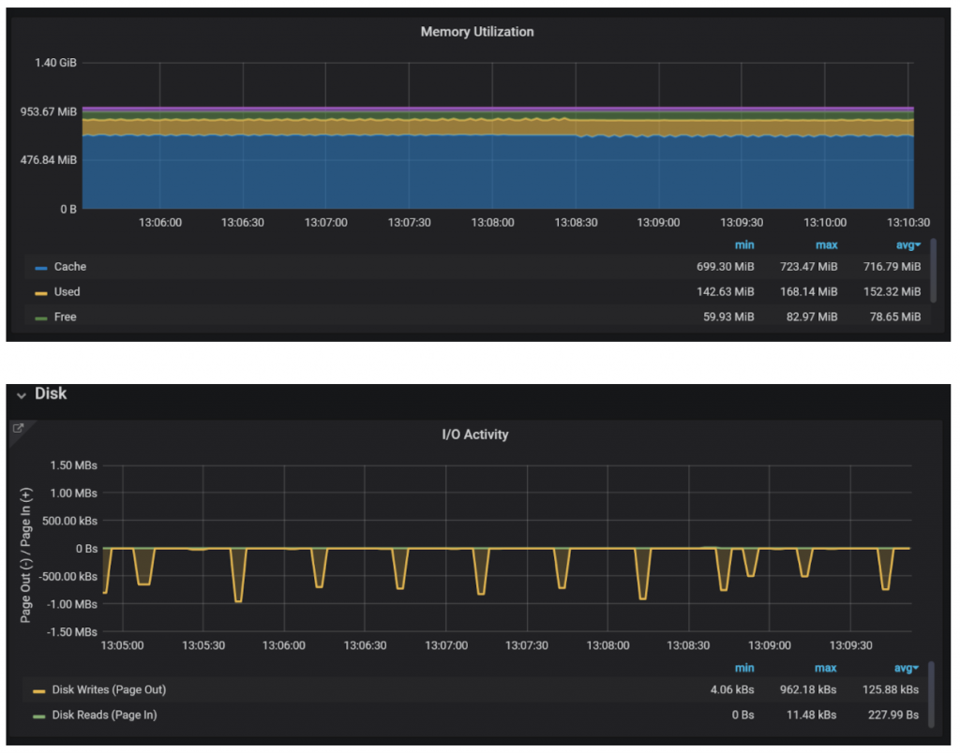
#7 Get More Memory

Slide 23
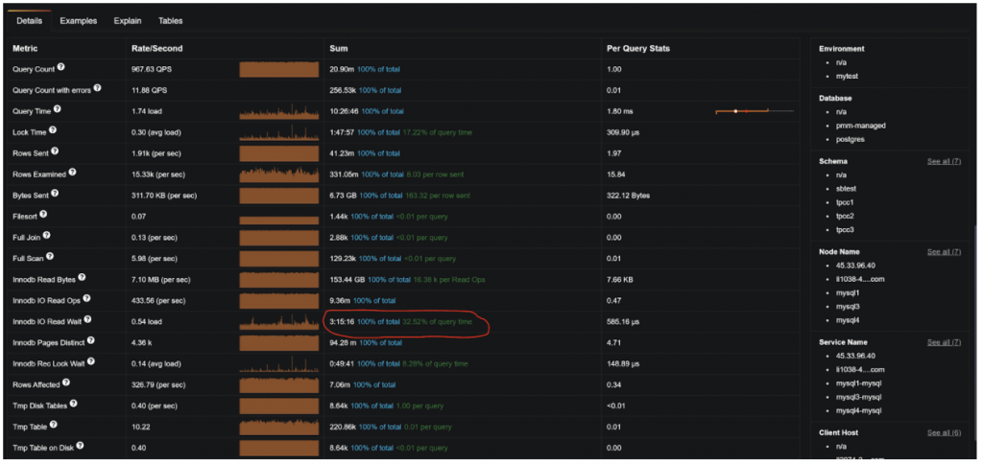
Specific Queries

Slide 24
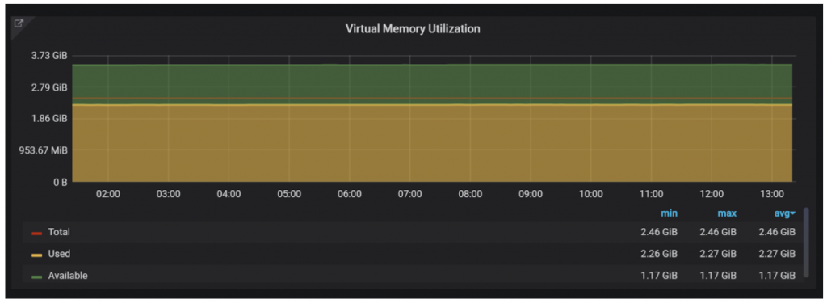
Do not Run out of Virtual Memory

Slide 25
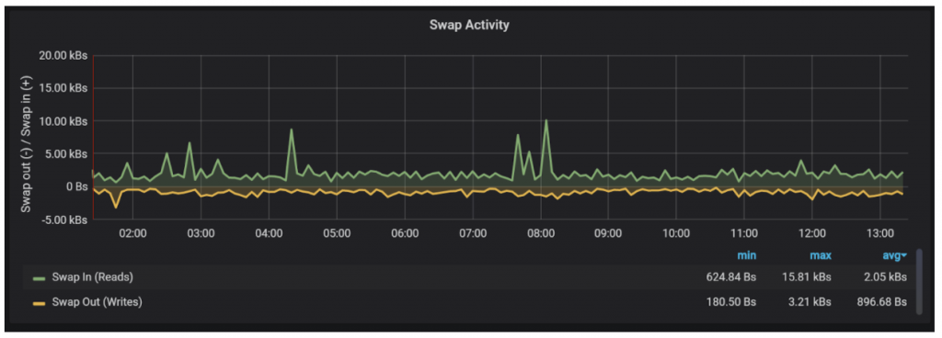
Beware Serious Swapping

Slide 26
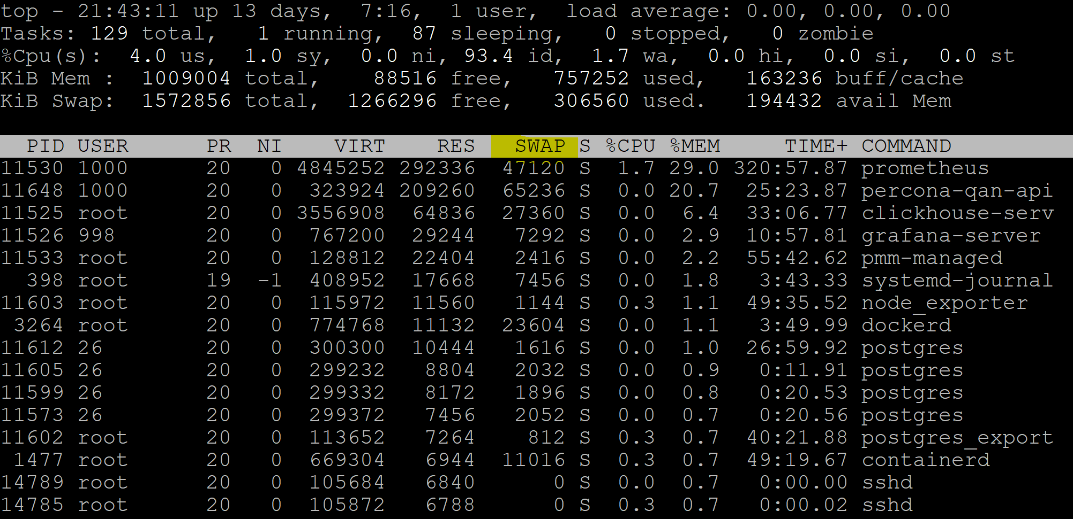
True Memory Usage by Process
Look at Resident + Swap

Slide 27
#8 Move to Faster Storage
Memory is faster than fastest storage
Fast Storage for Write Performance
Fast Storage for Read Performance, when data set is so large fitting in memory is impractical

Slide 28
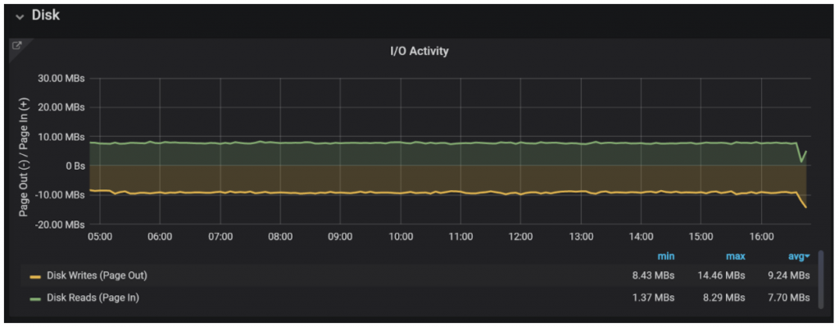
Amount and Type of IO Activity

Slide 29
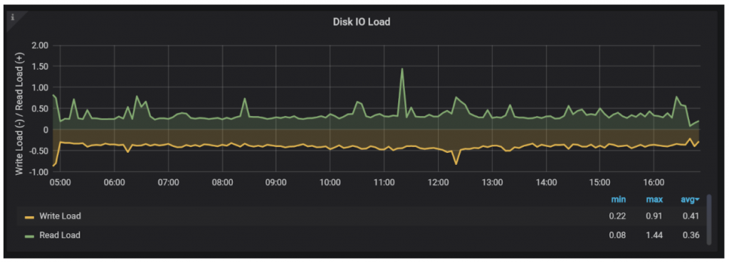
How Serious Load is it ?

Slide 30
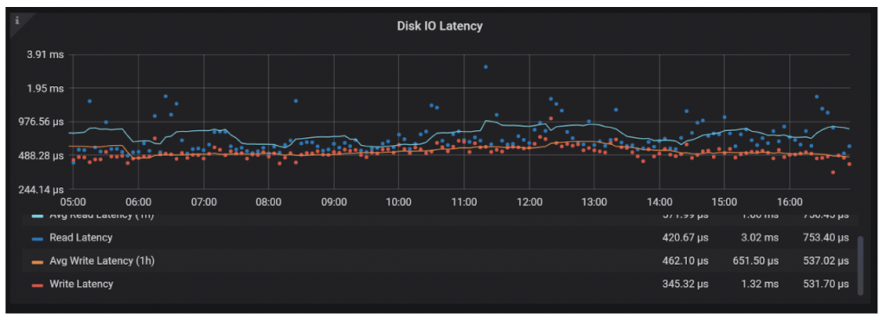
How Latency Compares to the Historical

Slide 31
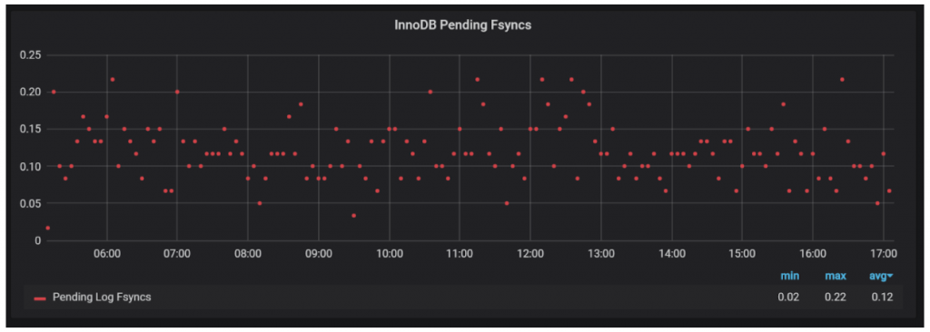
“Fsync” Is Special kind of IO

Slide 32
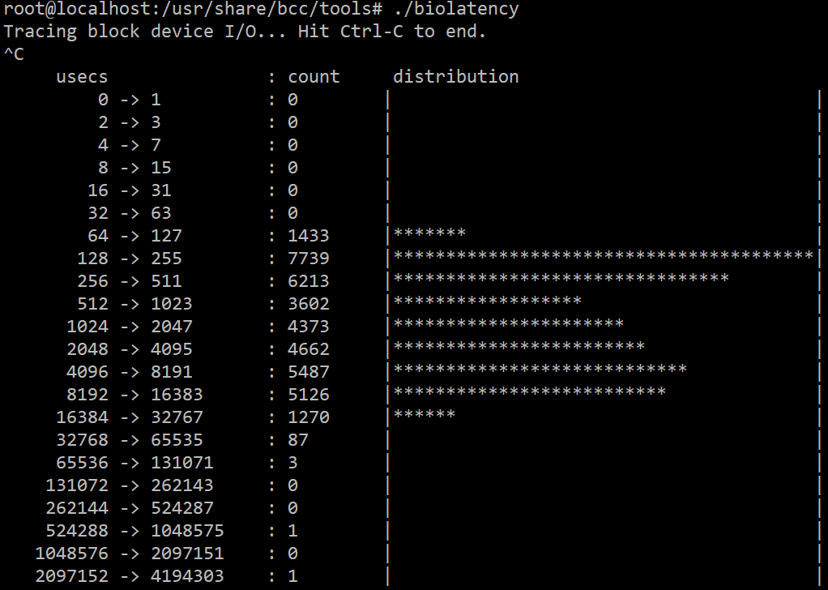
Biolatency: Block Device Latency
Tool from BCC Tools Collection https://github.com/iovisor/bcc

Slide 33
#9 Check your Network
Bandwidth
Latency
Packet Loss

Slide 34
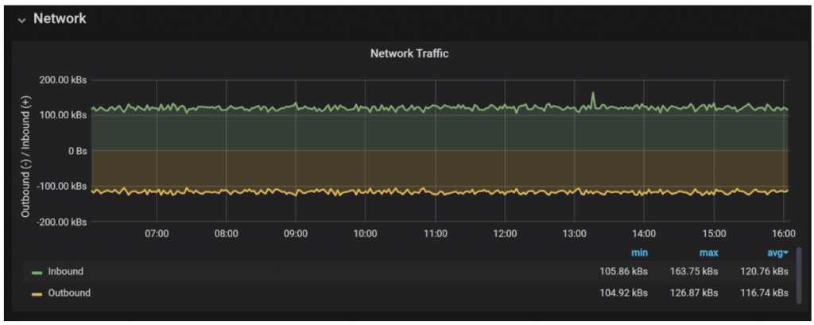
How Much Network Traffic do you Have ?

Slide 35
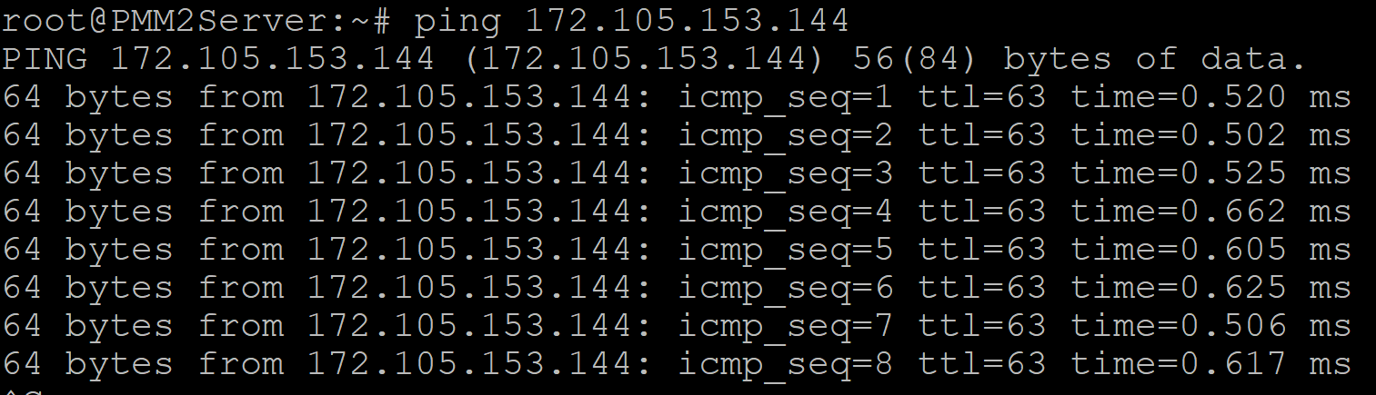
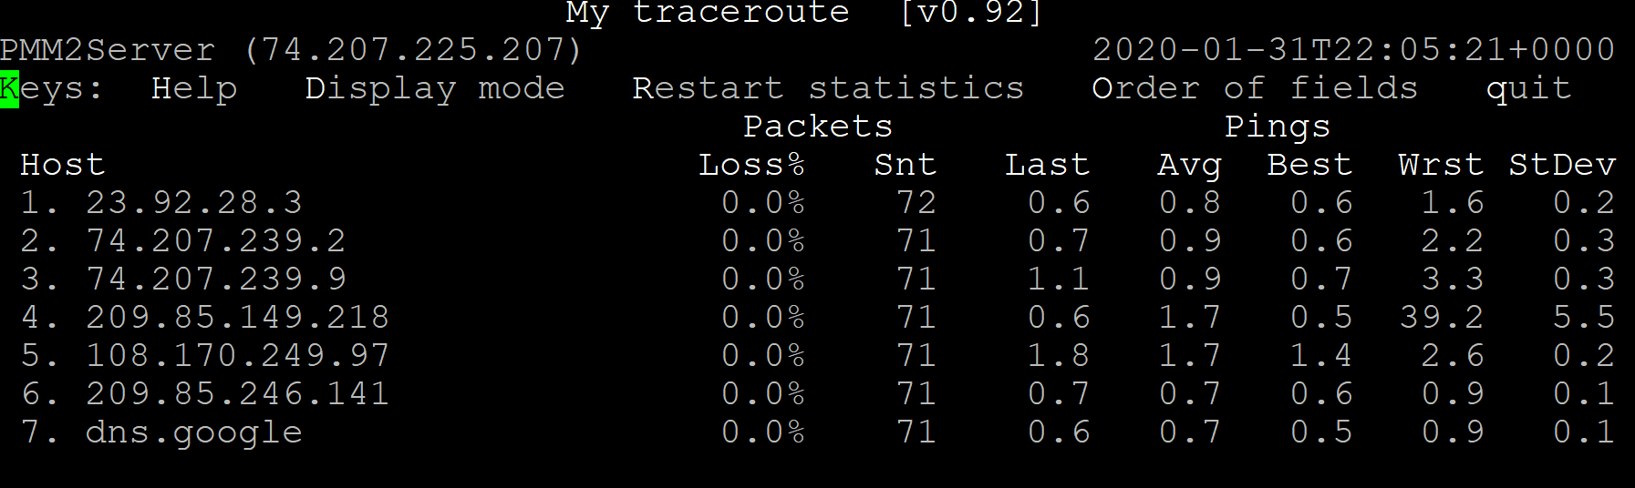
External Measurmenets

Slide 36
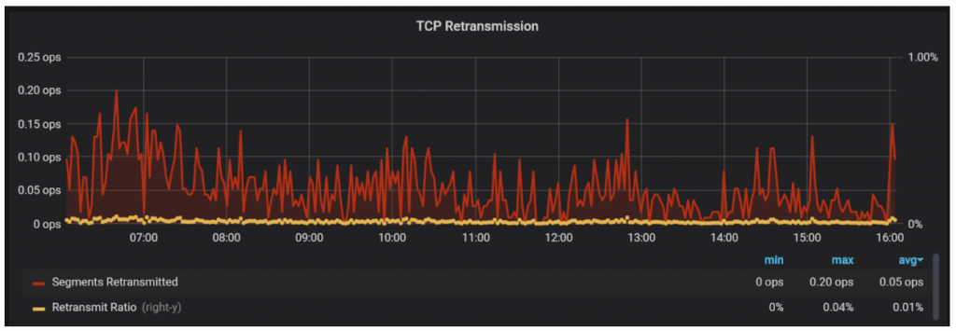
Retransmits – The silent Killer

Slide 37
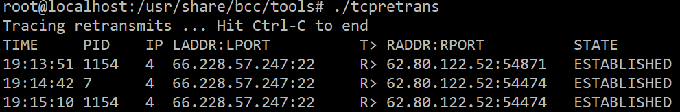
Where Retransmits come from
Tool from BCC Tools Collection https://github.com/iovisor/bcc

Slide 38
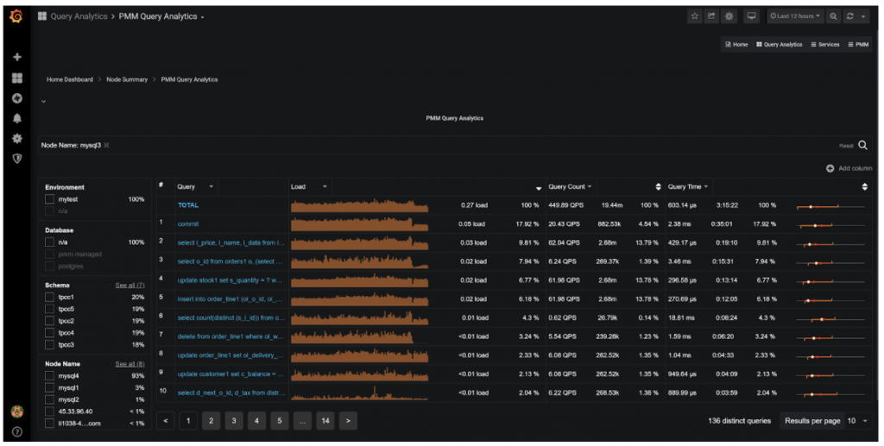
#10 Locate and Optimize Queries which cause the load

Slide 39
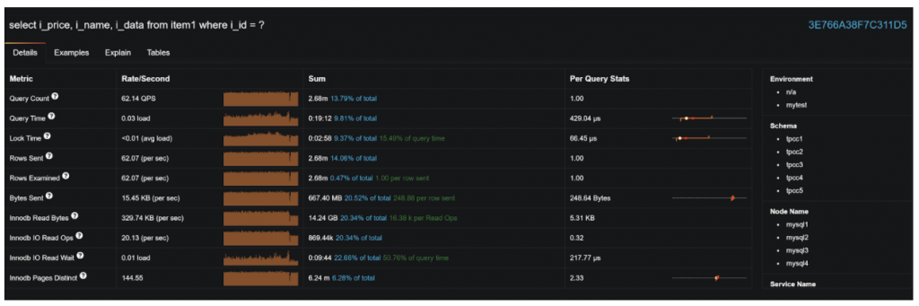
Query Execution Details

Slide 40
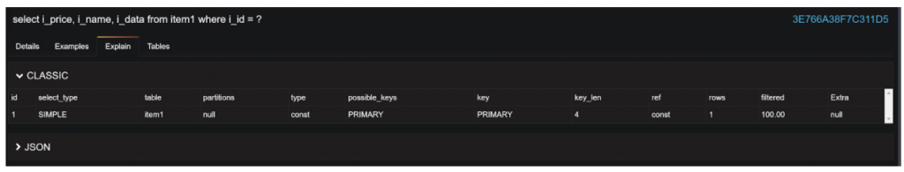
Check Explain

Slide 41
#11 Add Missing Indexes
Missing Index can cause query to run 1000s times slower than it should
Most Applications Have Some Missing Indexes
Index Purpose: Lookup Data, Sorting, Serving The Data

Slide 42
#12 Drop Unneeded Indexes
Indexes are Expensive both for Writes and for Reads
You only should have indexes you need – Drop Unused Indexes
Drop Duplicate Indexes
Assess Redundant Indexes for Dropping

Slide 43
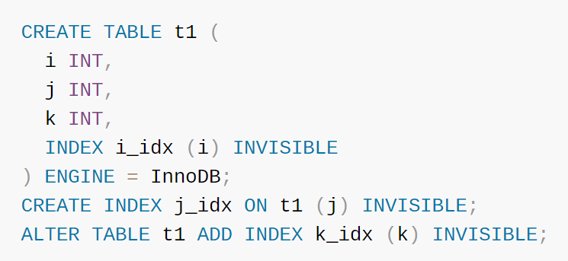
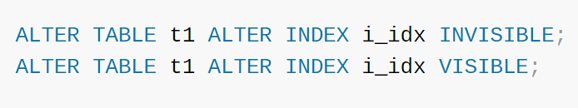
MySQL 8 Safety
https://dev.mysql.com/doc/refman/8.0/en/invisible-indexes.html

Slide 44

#13 Configure MySQL Server Properly
MySQL Defaults are not designed for High Performance Servers or High Intensity Workloads

Slide 45
Top MySQL Settings To Cahange
max_connections=N
table_definition_cache=M
table_open_cache=X
innodb_buffer_pool_size= 16G (70% of RAM)
innodb_flush_method=O_DIRECT
innodb_log_file_size=2G

Slide 46

Operating System Limits
Limit of Open Files is the most important for MySQL

Slide 47
#14 Purge Unneeded Data
Is old data needed in the same operational database ?
Move to different Server
Move to Archival Storage

Slide 48

Tool to Consider
pt-archiver

Slide 49
#15 Perform Database Maintenance
Database Stats getting out of sync – ANALYZE TABLE
Database Fragmentation and Bloat – OPTIMIZE TABLE

Slide 50
Optimizing All Tables
mysqlcheck –optimize -A

Slide 51

Word of Caution
Database Maintenance makes database faster but takes a lot of resources to run - not a good thing to do during peak load

Slide 52
#16 Check your Background Jobs
Can this Background Jobs postponed beyond Peak Times
Can this job be run on the replica (or other data jobs)
Am I avoiding batch job overlaps ?
Is this background job overdue for optimization ?
Can resources this background job uses be limited ? (throttling)

Slide 53
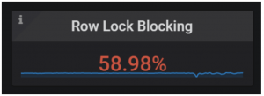
#17 Check for Data Hotspots
Data Hotspots – data objects (typically row) which have read, write or locking contention

Slide 54
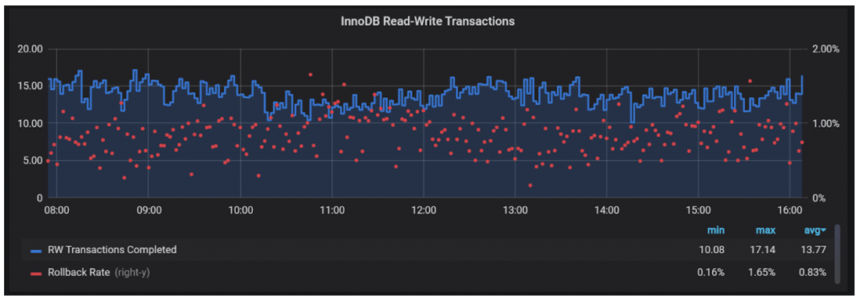
Can cause excessive Errors due to Rollbacks

Slide 55
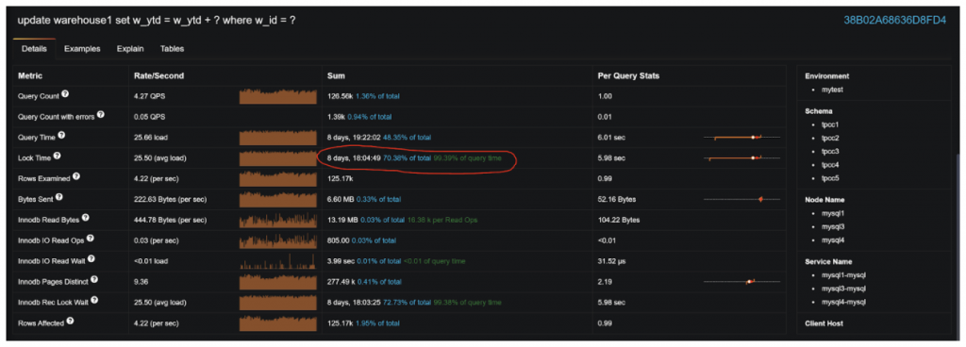
Can see specific queries having issues

Slide 56
#18 Check your Application Server Configuration
Re-Establishing Connections Unnecessary, Especially with SSL/TLS
Poor Connection Pool Settings
Poor Performance Settings (especially for JDBC)
Use of Prepared Statements
Caching Settings (if Available)

Slide 57
Summary
Facing Traffic spike with MySQL – Do not Panic
There are many tools available for you
Do not try applying all of them, pick most appropriate ones
Average system can candle at least 3x times traffic using only changing “low hanging fruits”

Slide 58


Slide 59
Thank you, Let’s Connect!
https://www.linkedin.com/in/peterzaitsev/
https://twitter.com/PeterZaitsev

